Slide 1
Section 5.1
Measures of Central Tendencies: Mean, Median, and Mode
© Copyright all rights reserved to Homework depot: www.BCMath.ca

Slide 2

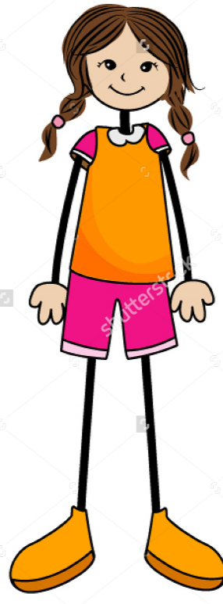
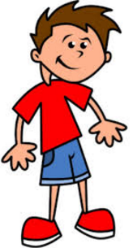
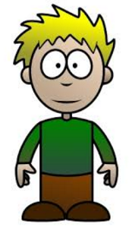
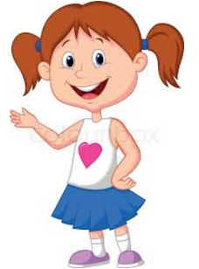
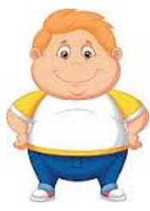
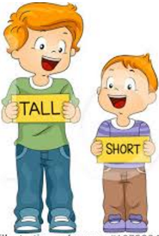


Who’s Taller? Boys or Girls?
Suppose you want to find out which gender in grade 8 is taller, how would you determine this?
Will you take the tallest student in your class to determine which gender is taller?
What if the tallest student is a girl, does that mean girls are taller than boys?
Or do you take the height of the shortest student?
Would you stack them up and get the total height of each gender?
One way to determine which gender is taller is by using Measures of Central Tendencies: Mean, Median and Mode

Slide 3
What are Measures of Central Tendencies?
A measurement of data that indicates where the middle of the information/data is located at
Ie: Which height is most common for each gender in grade 8
What is the average height of each gender
What is the middle height of all students of each gender
Activity: Each student is to measure their height and share the information as a class

Slide 4
Mean
Mean (average) is the most commonly used measure of central tendency
To calculate the average we know that we need to sum up all the data and then divide by the number of data values
Ex: Find the mean for the following values:
There are 8 terms
Get the sum by adding up all the terms
© Copyright all rights reserved to Homework depot: www.BCMath.ca

Slide 5
Median:
Median is the value that lies exactly in the middle of when all the data are arranged in ascending order.
To calculate the median we must first arrange the data from smallest to biggest
Then, the value that is exactly in the middle is the median.
If there are two numbers in the middle, we must average of the two middle values to get the median.
© Copyright all rights reserved to Homework depot: www.BCMath.ca

Slide 6
Ex: Find the median from the following set of values
Arrange the numbers from the least to the greatest
There are seven values and the middle is the fourth value
Arrange the numbers from the least to the greatest
There are two terms in the middle, get the average of the two to find the median
© Copyright all rights reserved to Homework depot: www.BCMath.ca

Slide 7
Mode:
Mode is the most frequently occurring value in a data set.
There may be more than one mode for a given data set if there is the same frequency of two or more numbers.
To find the mode choose the number that appears the most.
© Copyright all rights reserved to Homework depot: www.BCMath.ca

Slide 8
Ex: Find the mode for each set
Optional: Arrange the numbers from the least to the greatest
12 appears 3 times, so the mode is 12
Numbers 14 and 30 both appear 3 times, so the mode is both 14 and 30
© Copyright all rights reserved to Homework depot: www.BCMath.ca

Slide 9
Ex: The following table shows the quiz mark of 30 students. The quiz is out of 9. Find the measures of central tendencies for the following values:
To find the MEAN, understand that there are 2 people getting 4’s, six people
getting 5’s, four people getting 6’s, and so on
Frequency: how many times that value appeared
The MODE is the easiest to get:
Nine people got a mark of 8, so the mode is 8
Add up all 30 terms and then
divide it by 30
To find the MEDIAN, there are 30
values, the middle number will be
the 15th value.
Count from the bottom to find where the 15th value is
MEDIAN = 7
Average mark in the class is 6.766
© Copyright all rights reserved to Homework depot: www.BCMath.ca

